Slide 1

EXITEASE
A CHATBOT BASED OUTPASS GENERATOR

Slide 2

PROBLEM IDENTIFICATION
In many educational institutions, the outpass process is handled manually, which leads to several issues:
  Time-Consuming Process: Students have to get physical signatures from multiple authorities, which wastes time.
  Lack of Transparency: Students don't know the current status of their request or the reason for rejection..
  Manual Errors: Paper-based systems are prone to errors, misplacement, or unauthorized approvals.
  No Real-Time Tracking: Authorities and security personnel can’t track or verify approved requests efficiently.
  Inefficient Record-Keeping: No proper digital history or data for future reference

Slide 3
BASE PAPER
  "A Smart Leave Management System Using Chatbots“ This paper explores the use of AI-driven chatbots to automate leave request processes, streamlining approval workflows and reducing administrative burden. It highlights the integration of conversational interfaces in managing leave requests and approvals efficiently
  "Automating Student Leave Management System with Role-Based Access“ This study discusses the automation of student leave management using a role-based workflow for approvals. It outlines the benefits of reducing paperwork and enhancing transparency in the approval process by leveraging digital technologies.

Slide 4
OBJECTIVE
  To automate the outpass request and approval process using a chatbot.
  To provide a user-friendly interface for students to request outpasses.
  To implement a 3-level approval workflow with role-specific dashboards.
  To enable fast-track approvals during emergencies.
  To send notifications to students at each approval or rejection stage.
  To allow security to capture a photo of students leaving early or returning late.
  To flag outpass violations for admin review and maintain leave history records.

Slide 5
METHODOLOGY
  Requirement Analysis – Identify user roles and approval steps
  Chatbot Design – Create rule-based chatbot with fixed responses
  System Development – Use Flask for backend, MongoDB for data, HTML/CSS/JS for frontend
  Approval Flow – Implement 4-level approval with notifications
  Security Module – Allow photo capture and flagging for early/late exits
  Testing & Deployment – Test all functions and deploy the system

Slide 6
TECH STACK
  Frontend: HTML, CSS, JavaScript
  Backend: Python (Flask Framework) Rule-based Chatbot
  Database: MongoDB (for storing user data, requests, logs)
  Authentication:Flask-Login (for role-based access control)
  Notification:Flask-Mail (for request updates)

Slide 7
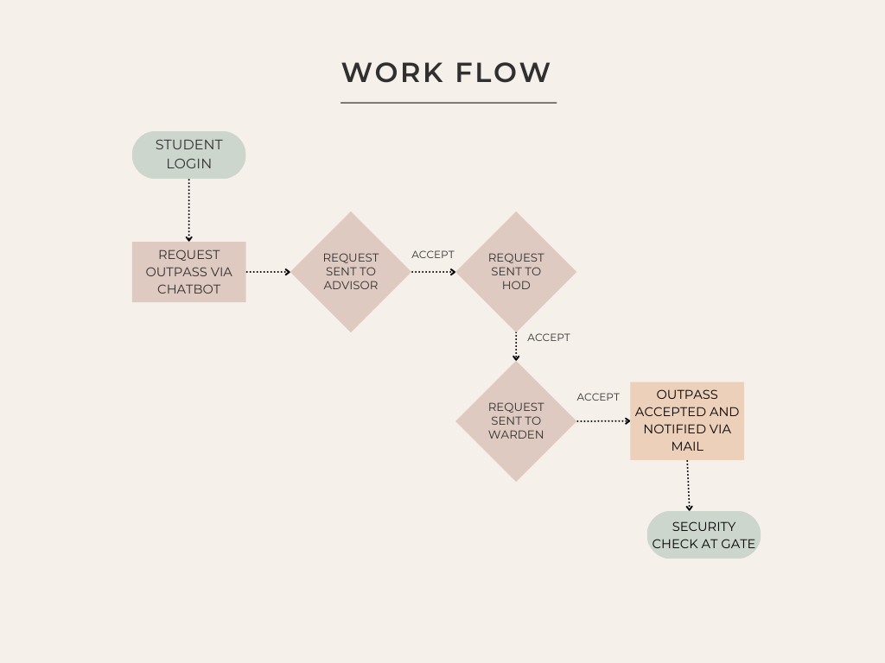
WORKFLOW

Slide 8
CONCLUSION
  The Exit Ease project successfully automates the outpass process using a rule-based chatbot.It ensures smooth and transparent approval flow, handles emergencies efficiently, and helps maintain discipline through security photo capture and flagging.
  This system reduces manual workload, saves time, and provides a digital record of all student movements, making it highly beneficial for institutions.

Slide 9
THANK YOU

